Slide 1


SMART FARMING USING MACHINE LEARNING AND IOT
Presented By:-
Komal Kumari-21033440015
Priyanka Kumari Verma-21033440026
Akanksha Jyoti- 21033440005
Rohit Kumar Mandal – 21033445017
MD.Warish Ansari – 21033445011
Guide- Mrs. Jyoti Kumari
Co-Guide-Amit Kumar

Slide 2
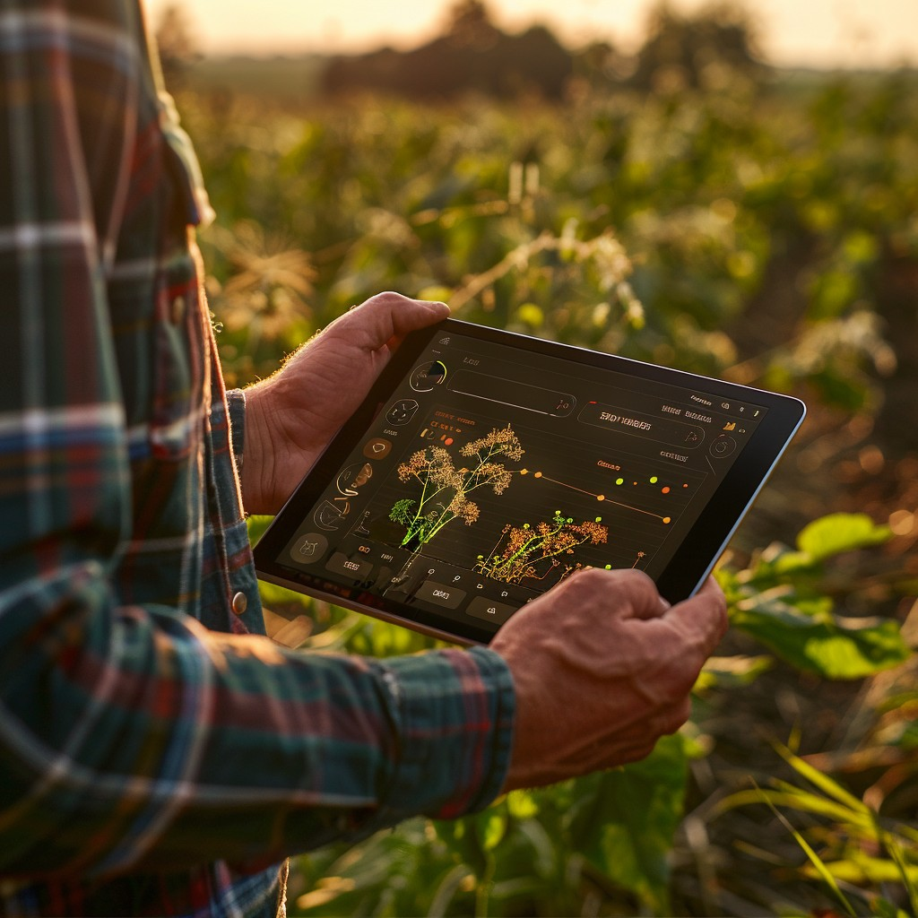
INTRODUCTION:-
Smart farming is the use of modern technology like sensors, machines and data analysis to make farming more efficient.
Nearly 58% of a country primary source of livelihood is farming.

Slide 3
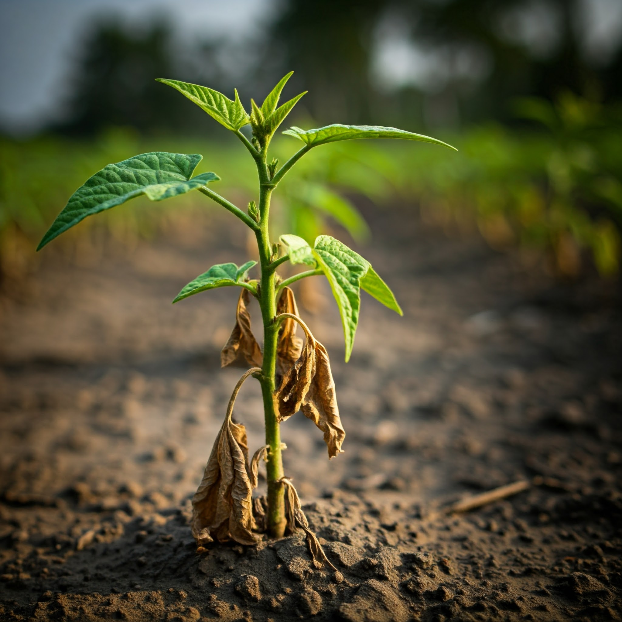
PROBLEM STATEMENT:-
20XX
Farmers face challenges such as unpredictable weather, soil degradation, and inefficient resource utilization, leading to reduced crop yield and increases costs.
Additionally, manual monitoring of large agricultural fields is time-consuming and labor-intensive.

Slide 4
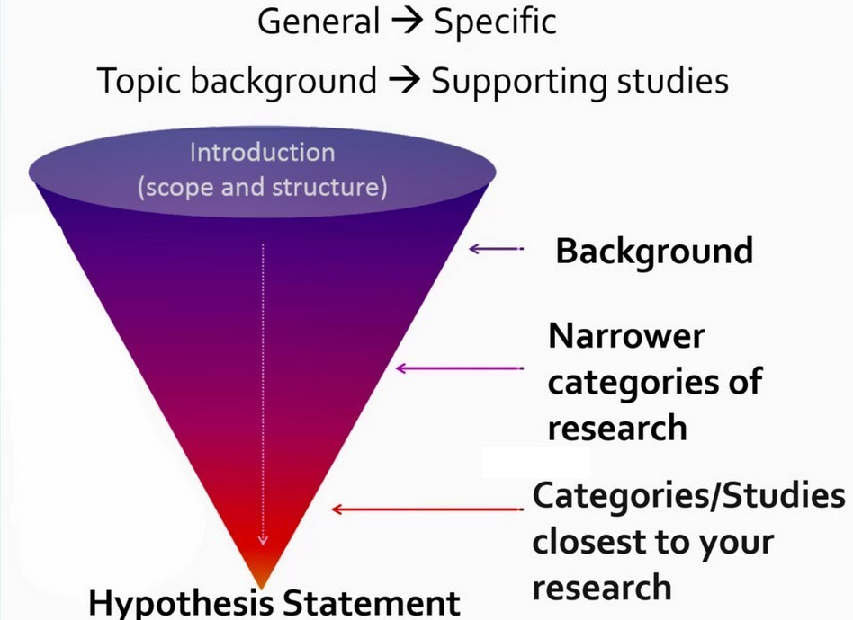
LITERATURE SURVEY

Slide 5
LITERATURE REVIEW
Title | Authors | Year | Findings
Machine learning and IoT-based smart farming for enhancing the crop yield | S.Sundaresan ,et.al | 2023 | Develops a system using machine learning to select crops, automate irrigation, and recommend fertilizers, aiming to reduce physical labor, energy use, and increase productivity.
IoT Based Smart Farming System using Machine Learning | Avinash Awasthi ,.et.al | 2024 | Presents an IoT-enabled smart farming system using AI for improved agricultural management, incorporating sensors for real-time monitoring and a Random Forest classifier for crop recommendations.
Assessment of Crop Quality Using Machine Learning Techniques for Smart Farming | Richard Essah ,et.al | 2023 | Proposes a novel architecture for continuous evaluation of crop quality using IoT and machine learning/deep learning, showing that data aggregation from multiple sources reduces percentage error in assessment.
An IoT Based Smart Farming System Using Machine Learning | A.Dahane, R.Benameur | 2020 | Explores the design and experimentation of a smart farming system with AI prediction capabilities, based on wireless sensor networks and involving data collection, cleaning, storage, and predictive processing.
Smart Farming: Internet of Things (IoT)-Based Sustainable Agriculture | Muthumanickam Dhanaraju, et.al | 2022 | Explores the use of IoT in smart farming for sustainable agriculture, discussing tools, applications, and challenges in integrating technology with traditional farming.
Smart Farming Using Machine Learning Algorithms | Vibha Pawar , et.al. | 2023 | Focuses on using machine learning algorithms to predict crop yield, aiding farmers in making informed decisions before cultivation.
Smart farming based on IoT to predict conditions using machine learning | Mochammad Haldi Widinto ,et.al | 2024 | Investigates the use of machine learning algorithms within IoT-based smart farming to predict agricultural conditions, particularly soil conditions.
Prospect of Machine Learning in Smart Farming | Prajwal R ,et.al | 2021 | Reviews the role of machine learning in smart farming, emphasizing its potential to enhance productivity and sustainability in agriculture.

Slide 6
Title | Authors | Year | Focus/Findings
The robust and efficient Machine learning model for smart farming decisions and allied intelligent agriculture decisions | Shraban Kumar Apat, et.al | 2022 | Proposing a novel machine learning approach for crop yield prediction using IoT-sensed data. Random Forest and Sigmoid activation showed high accuracy for crop yield prediction.
Smart Agriculture Using IoT and Machine Learning | Dr. Rekha J Patil, et.al | 2023 | Overview of a smart agriculture system using IoT and ML to maximize crop yields and product quality by real-time monitoring of soil moisture, temperature, pH levels, and water storage levels.
Evaluation of Machine Learning Approaches for Precision Farming in Smart Agriculture System: A Comprehensive review | Ghulam Mohyuddin, et.al | 2024 | Comprehensive review of ICT and ML's role in precision farming for smart agriculture, focusing on ML algorithms for environmental data analysis, crop prediction, disease detection, and irrigation optimization to maximize productivity and minimize environmental impact.
Integration of Wireless Sensor Networks, Internet of Things, Artificial Intelligence, and Deep Learning in Smart Agriculture: A Comprehensive Survey | Mushtaque Ahmed Rahu, et.al | 2020 | Survey exploring the integration of WSNs, IoT, AI, and DL in smart agriculture to enhance efficiency, productivity, and sustainability. ML algorithms provide predictive analytics for crop management, disease detection, and resource utilization, while DL models aid in image recognition for crop monitoring and yield prediction.
Farming in the Digital Age: Smart Agriculture with AI and IoT | Ali Ashoor Issa, et.al | 2024 | Review article on the transformative role of AI and IoT in modern agriculture, highlighting the integration of AI, IoT devices, machine learning, and sensor technology to enhance farming efficiency and productivity. Discusses the use of robotics, drones for crop monitoring, and smart irrigation systems leveraging real-time data.

Slide 7
Title | Authors | Year | Focus/Findings
Smart farming for improving agricultural management | Elsayed Said Mohamed, et.al | 2021 | Focuses on new approaches in smart farming from 2019 to 2021, illustrating data gathering, transmission, storage, analysis, and solutions using AI, IoT, and mobile internet. Discusses smart irrigation systems, UAVs, and robots for various agricultural functions.
SMART AGRICULTURE WITH IoT | Md Jowel Rahman | 2024 | Examines the digitalization of farming and finds ways to cultivate in challenging areas. The research explores sensor networks, data analytics, and communication technologies for real-time monitoring and control of agricultural processes, and includes a real-time demo with Arduino hardware and software.
MACHINE LEARNING APPLICATIONS IN IOT BASED AGRICULTURE AND SMART FARMING: A REVIEW | Pasan Maduranga, et.al | April 2020 | Review paper on IoT based smart agriculture using Machine Learning technologies for innovative research and data-driven farm management to increase productivity.
FARMIT: continuous assessment of crop quality using machine learning and deep learning techniques for IoT-based smart farming ⁵ | Ángel Luis Perales Gómez, et.al | 2022 | Presents a novel architecture based on IoT and Machine Learning/Deep Learning technologies for continuous assessment of agricultural crop quality, divided into three layers that gather, process, and analyze data from different sources. ⁸⁸⁸⁸
A comprehensive analysis on IoT based smart farming solutions using machine learning algorithms ⁹ | Ahamed Ali Samsu Aliar, et.al | June 2022 | Discusses smart agriculture/farming as an approach using current information and communication technology to improve agricultural product production and quality with minimum human involvement and lower cost, primarily based on IoT technology for continuous monitoring. ¹²
Internet of Things (IoT)-Enabled Machine Learning Models for Efficient Monitoring of Smart Agriculture ¹³ | MOHAMMAD ALDOSSARY, et.al | June 2024 | Introduces an IoT-enabled hybrid model for smart agriculture, integrating Machine Learning (ML) and Artificial Intelligence (AI) algorithms for cost-effective and reliable decision-making, including anomaly detection using various ML and deep learning models on dry beans and soil type datasets. ¹⁶

Slide 8
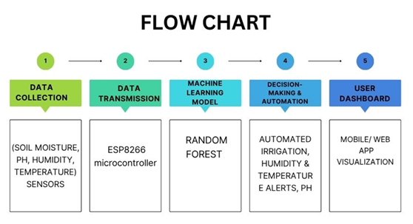
PROPOSED METHODOLOGY:-
Figure 1 Working Flow Chart Diagram

Slide 9
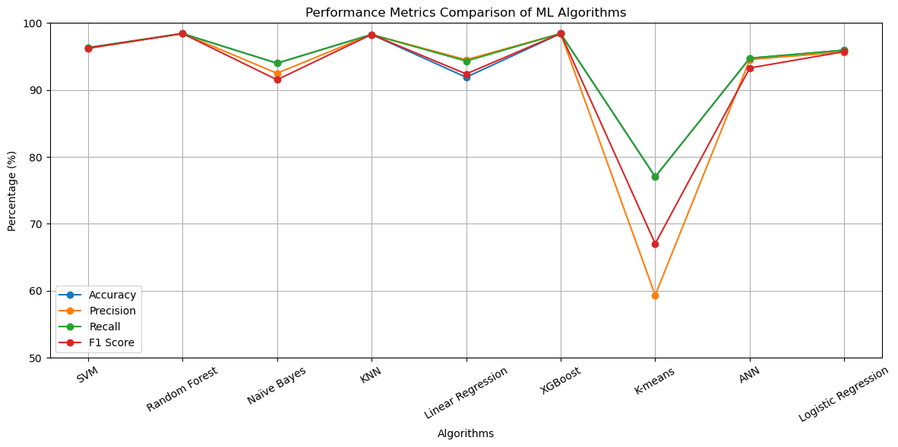
RESULTS:- Table 1 Accuracy of Algorithms
.
Algorithms | Accuracy | Precision | Recall | F1 Score
Support Vector Machine(SVM) | 96.31% | 96.19% | 96.31% | 96.24%
Random Forest | 98.42% | 98.43% | 98.42% | 98.42%
Naïve Bayes | 93.99% | 92.49% | 93.99% | 91.52%
KNN | 98.28% | 98.28% | 98.28% | 98.28%
Linear Regression | 91.89% | 94.51% | 94.31% | 92.39%
XGBoost | 98.42% | 98.43% | 98.42% | 98.42%
K-means Clustering | 77.02% | 59.33% | 77.02% | 67.03%
ANN | 94.74% | 94.54% | 94.73% | 93.28%
Logistic Regression | 95.94% | 95.67% | 95.94% | 95.72%

Slide 10
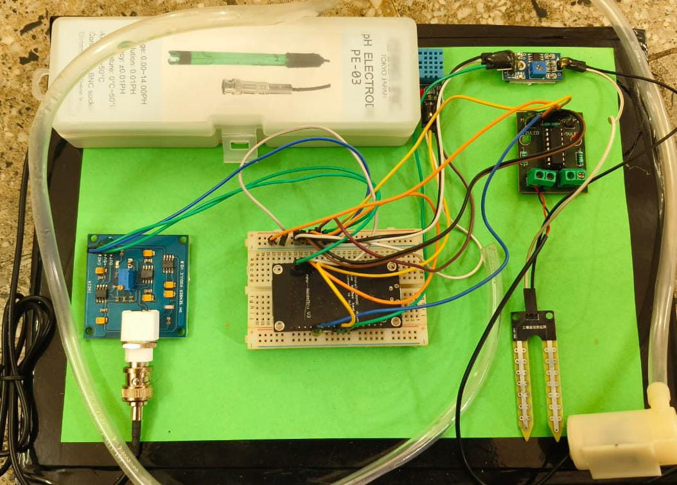
Figure 2 Experimental setup

Slide 11
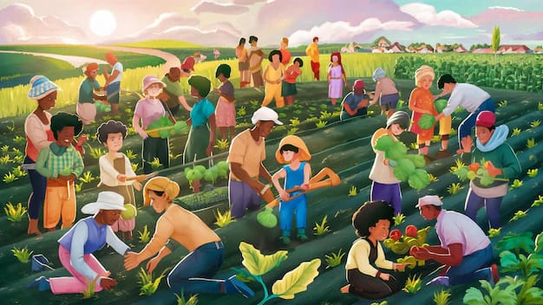
CONCLUSION:-
By integrating IoT sensors, the system enables real-time monitoring of crucial environmental parameters such as soil moisture, temperature, humidity, and pH levels, and also detects pests.
This automated data collection, coupled with intelligent analysis from Machine Learning models, empowers farmers to make timely and informed decisions regarding irrigation, fertilization, and pest control.

Slide 12
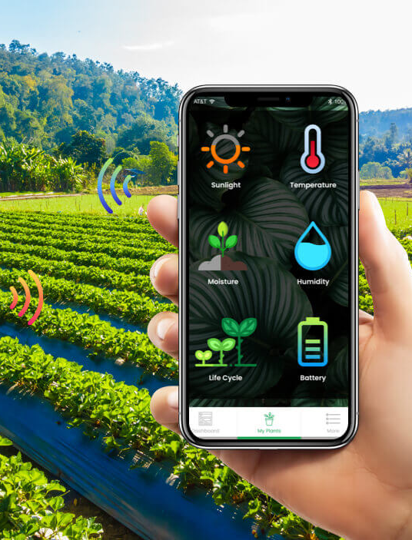
FUTURE SCOPE:-
We will implement deep learning models, such as CNNs, for more accurate crop prediction.
And Utilizing image processing for enhanced pest and disease detection.
Adopting cloud-based platforms for increased scalability.

Slide 13
REFERENCES:-
[1] Sundaresan, S., Johnson, S. D., Bharathy, V. M., Kumar, P. M. P., & Surendar, M. (2023, March).”Machine learning and IoT-based smart farming for enhancing the crop yield”. In Journal of Physics: Conference Series (Vol. 2466, No. 1, p. 012028). IOP Publishing.
[2] Avinash Awasthi, Shreshth Singh, Hemant Miranka A. (2024). An IoT based smart farming system using machine learning. In 2020 International symposium on networks, computers and communications (ISNCC) (pp. 1-6). IEEE.
[3] Richard Essah¹, Jonanthan Kwabena Boam², Anagrolia Faustino³ “Assessment of Crop Quality Using Machine Learning Techniques for Smart Farming”, International Journal of Research Publications and Reviews.
[4] Dahane, A., Benameur, R., Kechar, B., & Benyamina, A. (2020, October). An IoT based smart farming system using machine learning. In 2020 International symposium on networks, computers and communications (ISNCC) (pp. 1-6). IEEE.
[5] Dhanaraju, M., Chenniappan, P., Ramalingam, K., Pazhanivelan, S., & Kaliaperumal, R. (2022). Smart farming: Internet of Things (IoT)-based sustainable agriculture. Agriculture, 12(10), 1745.
[6]Vibha Pawar, Tejaswani More, Prandya Gaikwad.(2023 Jan). Smart Farming using Machine Learning AlgorithmB.Tech Students Department Computer Science and Engineering, Rajarambapu institute of technology,Sangli Mahasthtra India. e.ISSN 2395-0056.
[7] Widianto, M. H., Setiawan, Y. D., Ghilchrist, B., & Giovan, G. (2024). Smart farming based on IoT to predict conditions using machine learning. International Journal of Reconfigurable and Embedded Systems, 13(3), 595.
[8] Prajwal, R., & Rajesh, S. L. (2021). Prospect of Machine Learning in Smart Farming.
[9] Apat, S. K., Mishra, J., Raju, K. S., & Padhy, N. (2022). The robust and efficient Machine learning model for smart farming decisions and allied intelligent agriculture decisions. Journal of Integrated Science and Technology, 10(2), 139-155.

Slide 14
[10 Patil, R. J., Mulage, I., & Patil, N. (2023). Smart agriculture using IoT and machine learning. Journal of scientific research and technology, 47-59.
[11] Mohyuddin, G., Khan, M. A., Haseeb, A., Mahpara, S., Waseem, M., & Saleh, A. M. (2024). Evaluation of Machine Learning approaches for precision farming in Smart Agriculture System-A comprehensive Review. IEEE Access.
[12] Mustaque Ahmed Rahu, Sarang Karim, Sayad Mazhar Ali, Ghullam Murtaza Jatoi “Internet of Things, Artificial Intelligence, Deep Learning in Smart Farming”.
[13] Issa, A. A., Majed, S., Ameer, S. A., & Al-Jawahry, H. M. (2024). Farming in the digital age: Smart agriculture with ai and iot. In E3S Web of conferences (Vol. 477, p. 00081). EDP Sciences.
[14] Mohamed, E. S., Belal, A. A., Abd-Elmabod, S. K., El-Shirbeny, M. A., Gad, A., & Zahran, M. B. (2021). Smart farming for improving agricultural management. The Egyptian Journal of Remote Sensing and Space Science, 24(3), 971-981.
[15] Md Jowel Rahman “Smart Agriculture with Iot Device”. Centria University of Applied Sciences, Bachelor of information technology may 2024.
[16] Shi Lakshmi Chandana ,Dr. jayasri Kotti, Mr Vinod Motiram .Smart Agriculture :IOT Machine Learning for crop monitoring and precision farming”. Submitted :04/02/2024, Revised 12/03/2024, Accepted 18/03/2024.
[17] Aldossary, M., Alharbi, H. A., & Hassan, C. A. U. (2024). Internet of Things (IoT)-Enabled Machine Learning Models for Efficient Monitoring of Smart Agriculture. IEEE Access.
[18] Aliar, A. A. S., Yesudhasan, J., Alagarsamy, M., Anbalagan, K., Sakkarai, J., & Suriyan, K. (2022). A comprehensive analysis on IoT based smart farming solutions using machine learning algorithms. Bulletin of Electrical Engineering and Informatics, 11(3), 1550-1557.
[19] Angel Luis Perales Gomez, Pedro E. Lopez-de-teruel, (2022). Alberto Ruiz. continuous assessment of crop quality of crop quality using machine learning and deep techniques for iot -based smart farming. IEEE Access.
[20] Maduranga, M. W. P., & Abeysekera, R. (2020). Machine learning applications in IoT based agriculture and smart farming: A review. Int. J. Eng. Appl. Sci. Technol, 4(12), 24-27.

Slide 15
THANK YOU!

